Slide 1
Mock Interview
TIP101
Notes:
🌟 Purpose: Introduce the session and prepare students for mock interviews.
✅ What should I be doing?
Welcome students and set an enthusiastic tone for the session.
Explain the importance of mock interviews in preparing for technical interviews.
🎙️ What should I be saying?
Welcome to Week 10, Session 2 of TIP101! Today is a big day—we’ll be conducting mock interviews. This is an opportunity to practice the skills you’ve been building and to gain experience in a real-world interview setting.
Remember, mock interviews are about learning and improving. Mistakes are okay—they help us grow.
🙌🏽 How should I engage students?
Ask: "What’s one thing you’re looking forward to or feel nervous about in today’s session?" Acknowledge responses to build rapport.

Slide 2
1 | Welcome 👋🏽 | 10 minutes
2 | Mock Interview | 35 minutes
3 | BREAK | 5 minutes
4 | Collaborative Problem Solving | 60 minutes
5 | Wrap Up | 10 minutes
Notes:
🌟 Purpose: Outline the flow of the session and set clear expectations.
✅ What should I be doing?
Provide an overview of the agenda and ensure students understand the structure of the session.
🎙️ What should I be saying?
Here’s the plan for today: We’ll start with a mock interview demonstration, take a short break, and then move into collaborative problem-solving. We’ll finish with a quick wrap-up and reflection.
The focus today is on applying the UMPIRE strategy in a technical interview format.
🙌🏽 How should I engage students?
Pause for questions or clarification about the agenda.

Slide 3
Welcome! 👋🏽
10 minutes
Notes:
🌟 Purpose: purpose
✅ What should I be doing?
Stuff
🎙️ What should I be saying?
Stuff
🙌🏽 How should I engage students?
stuff

Slide 4


Turn on your cameras
Fill out the entry ticket
Notes:
🌟 Purpose: Encourage visual engagement to foster connection during the session.
✅ What should I be doing?
Prompt students to enable their cameras and submit the entry ticket.
🎙️ What should I be saying?
Let’s kick off our session by turning on our cameras!
Also, don’t forget to fill out the entry ticket to help us organize breakout rooms later.
🙌🏽 How should I engage students?
Use humor or compliments: "Let’s see those smiles!"
Acknowledge and thank students who turn on their cameras.

Slide 5
2 minutes
🎻🗣️Question:
Music helps some of us study better when we are heads-down and focussed! What genres/artists do you listen to when studying or working?
💬Answer:
Share your answer in the Zoom chat below. What kinds of pets do you have if any? If you don’t have any, share what type you would like to have, if any.

Slide 6
We made it to the final week! Will take some time to celebrate our achievements on Thursday
- End of Course survey submissions are low as of now, we will take more time to complete it this week.
Notes:
🌟 Purpose: Share feedback from the previous session and highlight areas of success and improvement.
✅ What should I be doing?
Summarize feedback from the previous session's survey and present key takeaways.
🎙️ What should I be saying?
From your feedback, it seems many of you enjoyed [highlighted aspect]. One suggestion was [area for improvement]. We’ll work on that today.
🙌🏽 How should I engage students?
Ask: "Does anyone have additional feedback or suggestions?"

Slide 7
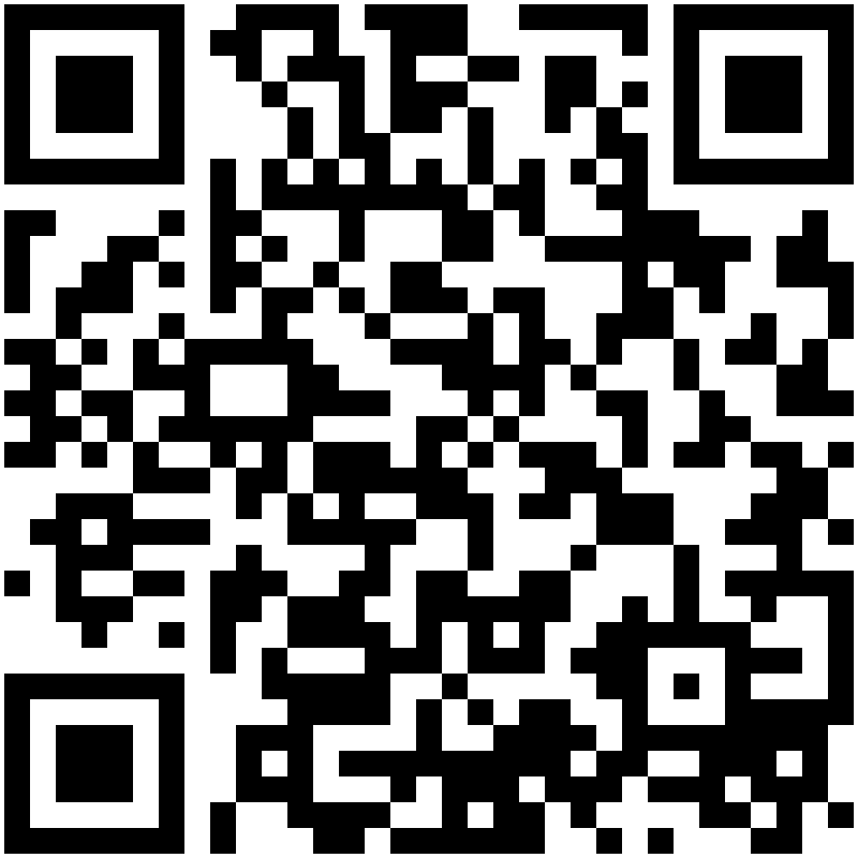
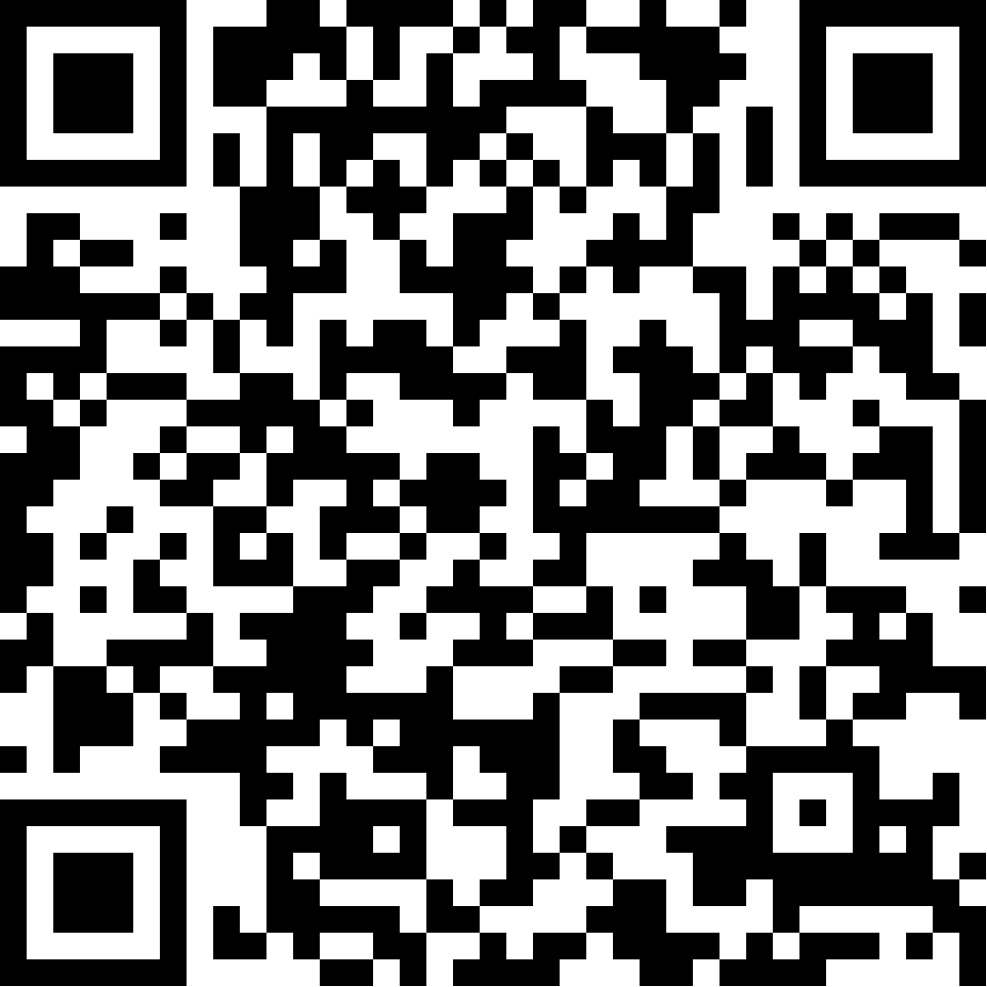
Interview practice with tech professionals
Limited spaces available!
Technical Interview Week August 17 - 20 Practice technical interview techniques and responses with experienced engineers
go.codepath.org/technical-interviews
QR code
Behavioral Interview Week August 24 - 27 1:1 mock behavioral interviews and feedback from tech professionals
go.codepath.org/behavioral-interviews
QR code
Don’t wait to sign up - popular timeslots fill quickly!
Notes:
I’d encourage you to take advantage of two upcoming opportunities to practice interviewing: Technical Interview Week and Behavioral Interview Week.
Each semester CodePath works with hundreds of tech professionals who volunteer their time to help you practice your interview skills - both behavioral and technical interviews.
You can sign up to take part in a 1:1 mock interview, followed by honest feedback and advice on where to improve.
It’s the best way to practice, grow your confidence, and also make a new professional contact. Definitely recommend signing up ASAP! Spots are limited and first come first served.

Slide 8
TF STAFFING IS OPEN · FALL 2026
CODEPATH*ORG
For Current Su26 students
Shortened application process for courses you’re taking (and passing) in Su26; app process validates your communication and teaching skills
SPECIAL PATH OPEN
HOW TO APPLY
Fill out our New TF Application
Current-student candidates will be considered on a rolling basis.
Apply before Aug 10th for greatest chance of securing a spot on our bench!
Aug 10
✓
✓
No technical pre-work for current course streams
The technical pre-work step is skipped on this path, for current courses.
✓
Finish your course
The special path may only apply once you become a completer.
Start your application →
Want to know more? We use a bench process - See the full role details on our Tech Fellow Wiki.

Slide 9
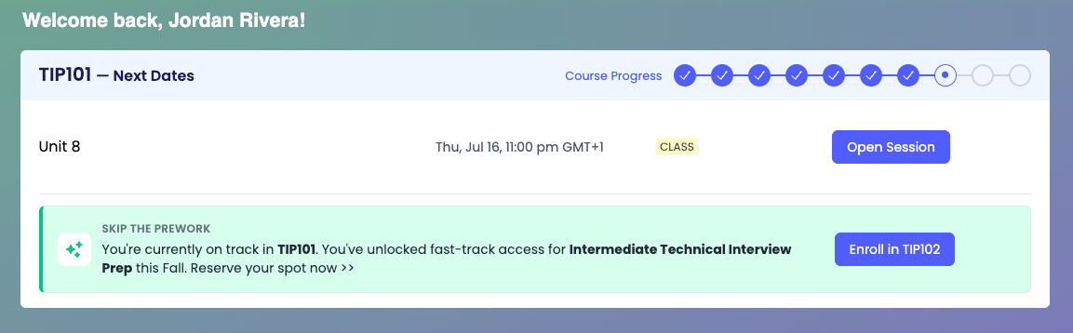
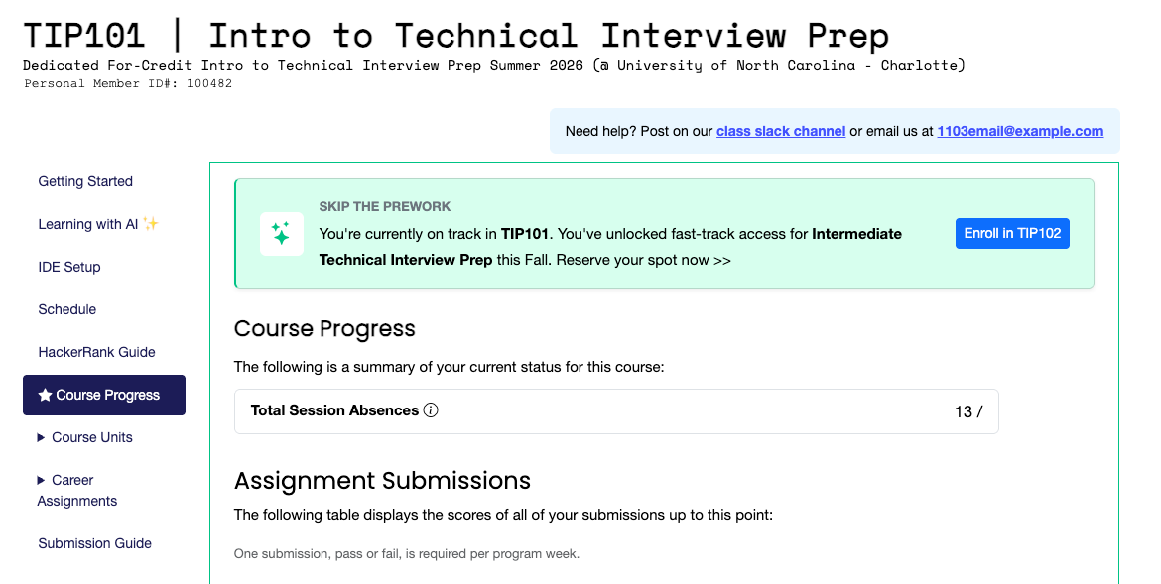
1
Student Hub dashboard
SKIP THE PREWORK
Your Fall 2026 seat is open
You're on track in your current course, so your seat at the next level up is open — no prework.
2
Course Progress tab in your course
Fast-track enrollment is open for Fall 2026 — take advantage of it this term.
Your seat may be contingent on passing, or completing, your current course.
Notes:
You're on track in your current course, so a Fall 2026 seat in the next one is already open — and you skip the prework. The green banner is live in two places: your Student Hub dashboard and the Course Progress tab in your course portal. It stays there until your course ends. Screens show TIP101 as an example.

Slide 10
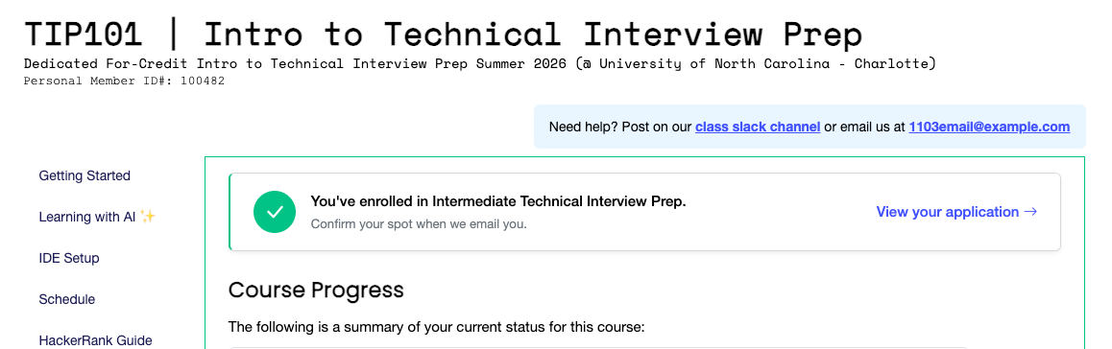
Join us
STEP 01
STEP 02
STEP 03
Click Enroll
Confirm by email
Finish your course
On the green banner, either place.
We'll email you — click Confirm Enrollment .
Pass and finish as a completer.
Enrolled — you'll see this
A green check replaces the banner.
Notes:
Three steps. Click Enroll, then watch for our email and click Confirm Enrollment — that is the step people miss — and finish your course: pass and finish as a completer. Once the course ends, your application lives under Courses in the Student Hub, which is also where to find the button if you didn't apply during the course.

Slide 11

Fall 2026 — CodePath, your future and you. We'll see you there.
Notes:
Simple close: Fall 2026 — CodePath, your future and you. We'll see you there.

Slide 12
Mock Interview
35 minutes

Slide 13
Today's Mock Interview
I will be the interviewer.
As the interviewer, I will simulate a realistic technical interview by asking probing questions and providing minimal hints when necessary.
A volunteer student will be the interviewee.
As the interviewee, you will think aloud while solving the problem, applying UMPIRE.
The rest of the class will observe: Observation form
Notes:
🌟 Purpose: Set the stage for the mock interview and explain roles.
✅ What should I be doing?
Explain the process, highlighting the interviewer, interviewee, and observer roles.
🎙️ What should I be saying?
For today’s mock interview, I’ll be acting as the interviewer. I’ll ask probing questions and provide minimal hints to simulate a real interview.
Our volunteer student will be the interviewee. You’ll think aloud as you solve the problem, applying the UMPIRE strategy. This helps everyone understand your thought process.
The rest of the class will observe, taking notes on what they would do similarly or differently.
🙌🏽 How should I engage students?
Encourage participation by asking: "Who would like to volunteer to be the interviewee today?"

Slide 14
Mock Interview Process
Quick intro (name, school, major)
Interviewer introduces the problem
Candidate opens VS Code to problem and shares screen
Candidate works through the UPI steps with interviewer
If you need to look something up, it's ok to Google it.
Say what you're thinking, what you're doing, and why.
Pay attention to feedback and hints from interviewer.
After: Celebrate and recap what went well!
Notes:
🌟 Purpose: Provide a step-by-step guide to the mock interview process.
✅ What should I be doing?
Clearly outline the steps for the mock interview to set expectations.
🎙️ What should I be saying?
Here’s how the mock interview will work: First, the candidate will introduce themselves. I’ll then explain the problem, and the candidate will open the link and share their screen.
As the candidate works through the UMPIRE steps, they’ll explain what they’re thinking, what they’re doing, and why. Remember, it’s okay to Google or ask clarifying questions.
Afterward, we’ll celebrate the candidate’s efforts and discuss what went well.

Slide 15
If you are not the candidate. . .
Hold all comments (on mic or in chat) until the end
Imagine what you would do in the candidate's shoes
Write down and be ready to share:
1 thing the candidate did that you will start doing too!
1 thing you'll do differently now that you've seen this interview.
Notes:
🌟 Purpose: Engage the observing students in active reflection and learning.
✅ What should I be doing?
Encourage observers to focus on takeaways they can apply to their own interviews.
🎙️ What should I be saying?
If you’re observing, hold your comments until the end. Imagine you’re the candidate—how would you solve this problem? What steps would you take?
Afterward, write down one thing the candidate did well that you’d like to adopt and one thing you’d do differently now that you’ve seen this interview.

Slide 16
Evaluation Criteria
🎯 Key Areas of Focus
Clarity
Problem-solving process
Use of the UMPIRE framework
🎗️ Reminders
Prioritize readability and logical flow over rushing to a solution.
Communicate effectively throughout to simulate a real-world technical interview scenario.
Notes:
🌟 Purpose: Highlight the key skills and behaviors being assessed during the mock interview.
✅ What should I be doing?
Explain the evaluation criteria and its importance in technical interviews.
🎙️ What should I be saying?
We’ll focus on three main areas: clarity, problem-solving process, and use of the UMPIRE framework. Clear communication is just as important as finding the right solution.
Prioritize readability and logical flow over rushing to the solution. Remember, this is about simulating a real-world technical interview.
🙌🏽 How should I engage students?
Ask: "Which of these criteria do you think is the most challenging to demonstrate? Why?"

Slide 17
UMPIRE
UNDERSTAND
IMPLEMENT
REVIEW
MATCH
PLAN
EVALUATE
Notes:
🌟 Purpose: Review the UMPIRE strategy to set a framework for problem-solving during the mock interview.
✅ What should I be doing?
Briefly recap the UMPIRE steps and their importance in solving coding problems.
🎙️ What should I be saying?
Let’s quickly revisit UMPIRE: Understand the problem, Match the right data structure or algorithm, Plan your approach, Implement the solution, Review your work, and Evaluate the time and space complexity.
This strategy helps you stay organized and methodical, which is crucial in a technical interview.
🙌🏽 How should I engage students?
Ask: "Which step of UMPIRE do you think you’ve improved on the most so far?"

Slide 18
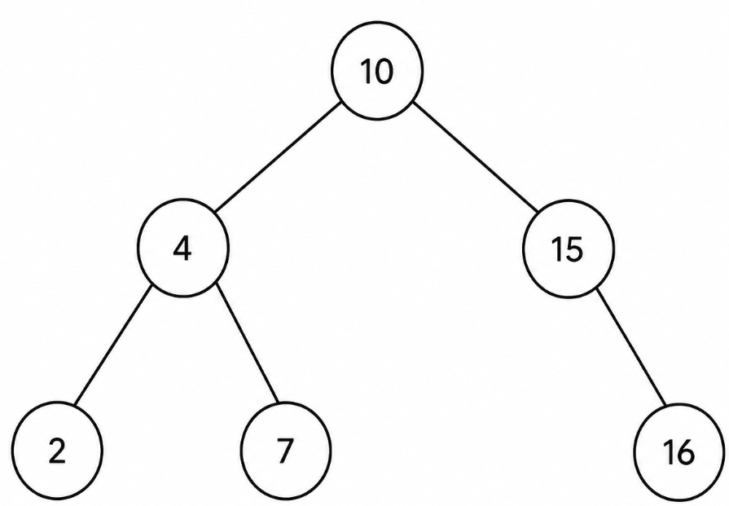
Problem #1
Given the root node of a binary search tree, return the number of nodes that contain even values. If the tree is empty, return 0.
Example Tree:
Output: 4

Slide 19
Problem #1 (continued)
Given the root node of a binary search tree, return the number of nodes that contain even values. If the tree is empty, return 0. Only consider leaf nodes when counting.
Example Tree:
Output: 2

Slide 20
3 minutes
In the chat . . .
What was one thing the candidate did that you will start doing too?
What is one thing you'll do differently now that you've seen this interview?
Notes:
🌟 Purpose: Reflect on the mock interview and encourage students to share takeaways.
✅ What should I be doing?
Facilitate a reflective discussion to consolidate learning.
🎙️ What should I be saying?
Let’s take a moment to reflect. In the chat, share one thing the candidate did that you’ll start doing and one thing you’ll do differently after watching this interview.
This is a great chance to learn not just from the candidate’s strengths but also from areas for improvement.
🙌🏽 How should I engage students?
Read a few responses aloud, emphasizing insightful or actionable takeaways. Encourage follow-up thoughts: "Why do you think that strategy worked well?"

Slide 21

Break Time!
Take 5 mins to step away from the computer. Feel free to turn off your camera and return promptly after 5 mins.
Notes:
🌟 Purpose: Provide a short break to refresh and re-energize.
✅ What should I be doing?
Announce the break and remind students to return on time.
Play the countdown timer video (be sure to share sound).
🎙️ What should I be saying?
Let’s take 5 minutes to step away from the screen. Be sure to return promptly.

Slide 22
Collaborative Problem Solving
60 minutes

Slide 23
60 minutes
🏃🏽 Navigate to your breakout room.
👋🏽 Introduce yourselves!
🧑🏽‍💻 Work on the problems for your selected unit.

Slide 24
Wrap Up
10 minutes

Slide 25
Notes:
🌟 Purpose: End the session on a positive note.
✅ What should I be doing?
Prompt students to share their reflections in the chat.
🎙️ What should I be saying?
Let’s celebrate your wins. Share one good thing you learned or accomplished today!
🙌🏽 How should I engage students?
Read a few responses aloud and celebrate with enthusiasm.

Slide 26


End of Course Survey Time!
5 min for End of Course Survey
Check your email for the link
Notes:
🌟 Purpose: Gather feedback to improve future sessions.
✅ What should I be doing?
Share the survey link and emphasize its importance.
🎙️ What should I be saying?
Your feedback helps us make these sessions even better. Please take a moment to complete the survey.
🙌🏽 How should I engage students?
Thank students for their input and explain how feedback has been used in the past.

Slide 27

Final Reminders
Finish the problem sets for additional practice
Your final HackerRank assessment is due by Sunday @ midnight
Visit a Study Hall Session to deepen your understanding, work through challenges, and connect with course material alongside your peers!
Sign-Up for Future Opportunities!
Interview Prep sessions
Interested in being a Tech Fellow? Start your application
Enrolling in your next class? Check out Fast Track Enrollment
Notes:
🌟 Purpose: Reinforce key tasks and deadlines.
✅ What should I be doing?
Summarize next steps and encourage continued engagement.
🎙️ What should I be saying?
Don’t forget to complete the problem sets and take the HackerRank assessment by Sunday!
🙌🏽 How should I engage students?
Encourage students to ask any lingering questions before signing off.

